Slide 1
User Web Interactions Prediction: SPRINT 3
Gabriel Falcones Paredes
Spring 2021

Slide 2
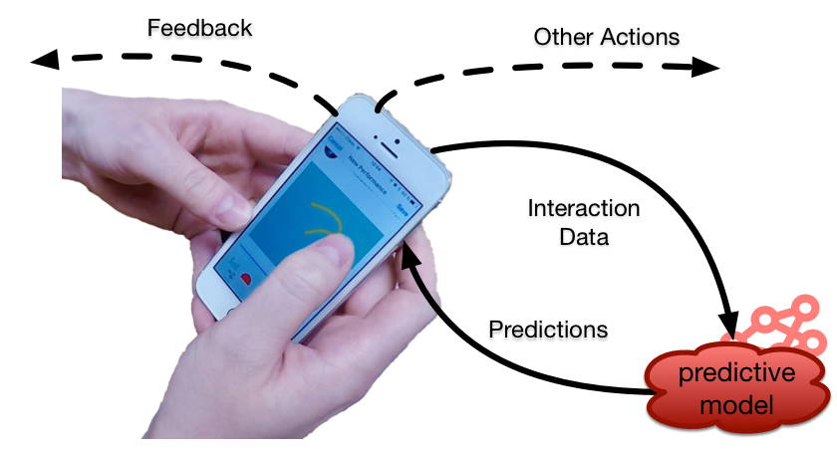
Project Description
Implementation of machine learning system to predict user interactions on a web application.
Uses:
Improve browser experience
Pre-send, pre-fetch data
recommendations
web caching
recover from errors

Slide 3
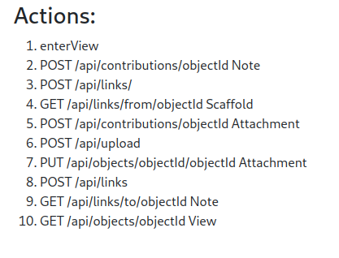
Sprint 3
Expand dataset with more features/interaction types and retrain model
Query Database to obtain more information on Contributions
Get Additional Contribution Information from POST Data (unavailable from logs).

Slide 4
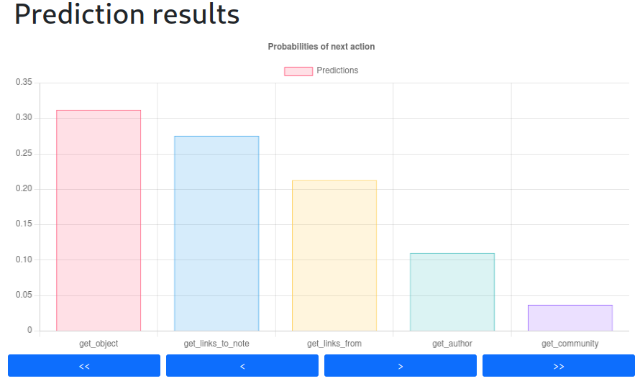
Sprint 3
Create web server to handle requests and return predictions
  Receive user interactions in real time
  Return possible future actions
  Display results
  Store requests in DB to use them to re-train model
Technologies:
Server: Python3 Flask Microframework
Client: ReactJs
SocketIO
React-ChartJs
SQLAlchemy ORM

Slide 5
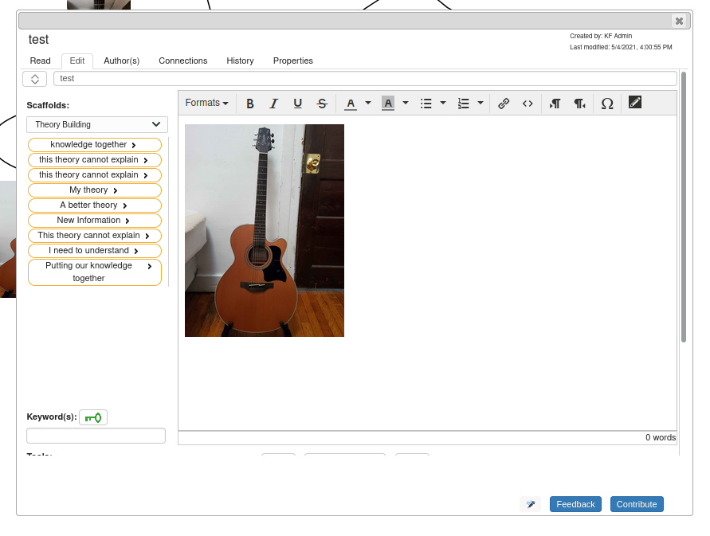
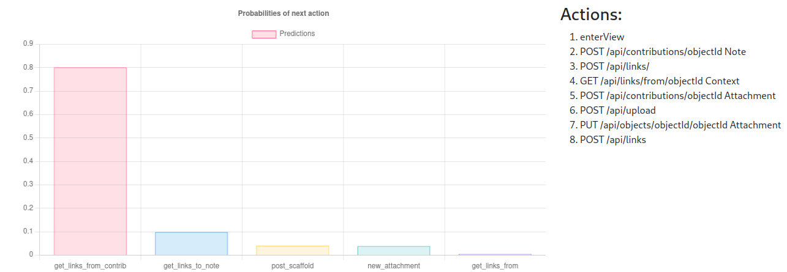
Sprint 3
Integrate with knowledge forum server/client.
  KF Server sends requests to prediction server when user interacts on KF client, and receives prediction probabilities

Slide 6
Sprint 4
Retrain model with more sequence actions/features.
Set endpoint on prediction server to allow automatic retraining of model.
Deploy prediction server

